Slide 1
Data Driven Requirement Engineering
By:
Ankita Wankhede
Manasa Reddy
SaiJyothi
Rashmi Tripathi

Slide 2
Requirement Engineering
Requirement engineering is the process of establishing
Services that customer requires from a system.
Constraints under which it operates and is developed.
Requirements are the descriptions of the system services and constraints that are generated during the RE process
The use of word engineering here implies that systematic and a repeatable technique need to be used to ensure the requirements are complete, consistent and relevant.

Slide 3
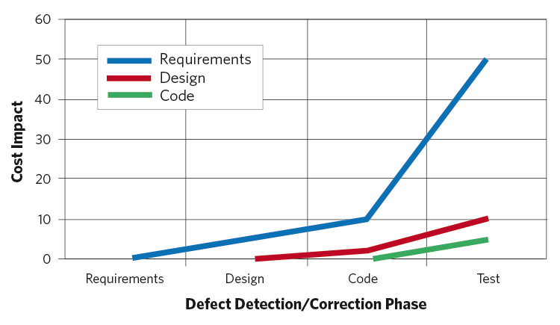
Conventional Methods
Brainstorming
Document Analysis
Focus Group
Interface Analysis
Interview
Observation
Prototyping
Requirements Workshop
Reverse Engineering
Survey

Slide 4

Feedback, Forums & Review - Analytics
This form of requirement engineering involves gathering information though
User Feedback
User Forums
Review Systems
Usage Data, Logs & Interaction traces
With the emergence of the Social
media and app stores, its easy to quickly
gather information from users like
Review releases
Report bugs
Rate Apps and features
Request New features

Slide 5

Data Driven Requirement Engineering
The Challenge lies in arranging and analyzing the data to generate meaningful information.
Collecting the User logs, feedbacks, usage data to understand and react.
How to convert the information in to a requirement engineering process.

Slide 6
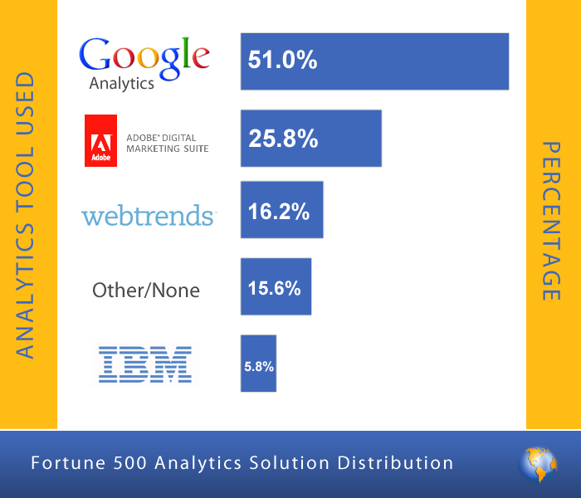
User Feedback Analytics
Analytics is the use of analysis, data and systematic reasoning to make decisions. It might include feature request.
App store Operators such as Google, Apple, Microsoft offer analytics services based on user feedback.
Analytics services focus on sales, marketing decisions, user demographics and sales behaviour.

Slide 7
Classifying User Feedback
User Feedback might include
Bug report – Crash or performance issue
Feature request
Adding or changing features
User experience document
Rating comment

Slide 8
Filtering User Feedback
Analytics tools can help classify and filter user feedback according to the information it contains.
Researchers have studied how to use text classification , natural language processing and other heuristics to categorize reviews.
Feedback describing user experience can serve as an ad hoc document for software or to derive user stories.
Automatic feedback classification can provide an overall picture of app usage and user engagement.

Slide 9
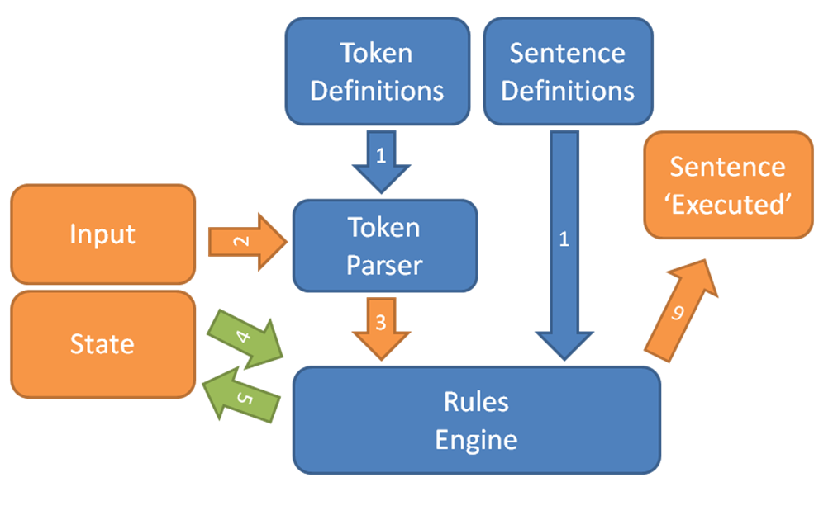
Natural Language Processing

Slide 10
Classifying Stakeholders
Analytics help identify and classify use groups and stakeholders with different characteristics and needs.
Analytic tools can mine feedback to identify descriptions of usage patterns, uncommon vocabulary or role and task descriptions
Classifying stakeholders might help analysts identify, understand and specify non functional requirements more concretely.

Slide 11
Summarizing Reviews
Researchers suggested two probabilistic approaches to summarize informative review content.
1. Feature-based summarization
2. Topic-based summarization

Slide 12
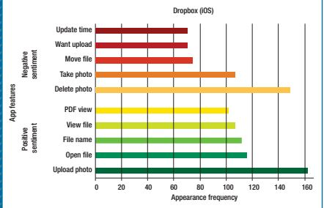
Feature Based Summarization
To summarize the features, researchers have applied sentiment analysis and natural language.
This analysis helped the researchers to
prioritize their work for the next
releases.
This analysis also made the sentiment
Analysis more challenging

Slide 13
Topic Based Summarization
A tool is described for summarizing the informative app reviews which is AR-Miner, proposed by Ning Chen.
This tool first filters the noisy and irrelevant reviews.
Now, it summarizers and ranks the informative reviews based on topic modelling.
The main moto of the tool is to summarize and visualize the review topics based on the requirement.

Slide 14
Similar Apps: Looking Beyond The Fence
The information about the similar apps are combined with the reviews and rating comments had helped to identify and prioritize new app requirements.
By examining similar apps, before creating new apps we can combine the existing features and come up with new innovative ideas to improve the performance of the app.

Slide 15
Implicit Feedback From Usage Data
Very often negative feedback isn’t useful for the developers as they are not much informative.
Users generally discuss more on positive responses and thus positive responses and usage data help in better understanding the reviews.
Usage data helps in better understanding the users feedback and responses.
Usage data is further analyzed, filtered, summarized and visualized to make the developers work easier.

Slide 16
The Future of RE Decision Making
Inconsistent
No Change support
Much better
stakeholder-centered
intuition/rationale based decisions
business requirements
system and technical requirements
requirements interdependencies
group-based
mass-driven
user-centered decisions
Forums/social media
review platforms

Slide 17
Best option : known and used data sources + aggregated user data
Technically : New data analytics like predictive modeling, Delphi analysis,
scenario analysis are needed to integrate above information
How ?
Reactive decision making - - > Proactive decision making
Any significant changes in below need to get adjusted in development process:
Objectives
Priorities
Dependencies
When?

Slide 18
Group of unknown users with the help of social media platform
Crowdsourcing could enlarge the set of stakeholders who generate
and manage requirements.
Communication between vendors to users need to change
unidirectional → bidirectional
Who?
Constant changes in decisions content over time
Requirements are implemented incrementally to get best target software
Eg: Game features are eliminated or enhanced based upon user response
Explicit and implicit user feedback should be taken into consideration more for decisions about what and when to implement and deliver
What?

Slide 19

Proper tools required for analysis scaling and users management | motivate users to provide correct input for unaccountable features by providing incentives
Need validation on sample of users | crowd data will most likely lead to conflicting contributions that need resolution

Slide 20
Conclusion
Requirements identification, negotiation, and analysis need stronger interaction between developers, analysts and users.
Must for many software products but doesnot apply to all
Extreme challenges are present
“Changing software engineering teams’ mind-set to accept users as equal stakeholders with potentially good ideas and suggestions is an important cultural challenge.”

Slide 21


